Slide 1
Proposition 65 Update
Fresno Visalia Bakersfield Los Angeles Sacramento
1

Slide 2
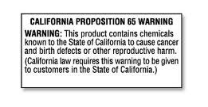
Proposition 65 Origins
Proposition 65 originated as an initiative approved by the people of California in 1986 to require businesses to provide clear and reasonable warning before exposing people to certain chemicals that exceed certain thresholds.

Slide 3
The Operative Language
Section 25249.6 California Health and Safety:
No person in the course of doing business shall knowingly and intentionally expose any individual to a chemical known to the state to cause cancer or reproductive toxicity without first giving clear and reasonable warning to such individual. Except as provided in Section 25249.10.

Slide 4
The Prop 65 List of Chemicals
Broad Range of Chemicals (over 850)
Includes a Number of Common Chemicals
Includes chemicals that are commonly found in food and beverages

Slide 5
Interesting Prop 65 Chemicals
Cigarette Smoke
Diesel Fumes
Saw Dust
Sulphur Dioxide
Ethyl Alcohol
Round Up

Slide 6
What's Hot with Other Products
Di(2-ethylhexyl)phthalate (“DEHP”) in Plastics- Tools, Vinyl Clothes, Purses
DEHP in eyewear
Tris in furniture
Lead in Various Types of Food and Supplements
Coconut oil diethanolamine in cosmetics, soaps, shampoo
BPA in Plastic Items
Carbon Monoxide in Combustible Items

Slide 7
How Chemicals are Added
Chemicals may be added to the Prop 65 list by…..
Chemicals identified by WHO.
Chemicals identified by CA’s “qualified experts.”
Chemicals identified by “authoritative bodies.”
Chemicals that a state or federal government agency requires to be labeled as causing cancer or birth defects.

Slide 8
Limitations
Companies Under 10 Employees.
Federal Preemption
Occupational Hazards Covered by the Hazcomm Standard
Prescription Drug Presumption
12 month period after the chemical is initially listed before a violation could occur

Slide 9
Exposure, means:
25102(i) “Exposure” means to cause to ingest, inhale, contact via body surfaces of otherwise come into contact with a listed chemical.
Three classes of exposure: as a consumer, as an employee, or in the environment. Each will impact the scope of the required warnings.

Slide 10
“Knowingly” means knowledge that the discharge is occurring NOT that it is unlawful
25102(n) “Knowingly” refers only to knowledge of the fact that a discharge of, release of, or exposure to a chemical listed pursuant to Section 25249.8(a) of the Act is occurring. No knowledge that the discharge, release or exposure is unlawful is required.

Slide 11
Do You Need A Warning
How do you know whether you need a warning?
Need to know what is in your product
Need to know whether under the dosage situation:
You exceed the NOEL or in the case of reproductive effects the MADL.
If there is no MADL or NSRL you need an expert to provide you with that opinion.
What if you are over?
Provide the appropriate warning
Or if you can find out what is causing the levels and reduce them, change or eliminate the ingredients.

Slide 12
No Warning Requirement if the Levels are less than the NSRL and NOEL
(c) An exposure which… poses No Significant Risk [NSRL] assuming lifetime exposure at the level in question for substances known to the state to cause cancer, (1 in 100,000 cancer risk)
and that the exposure will have No Observable Effect [NOEL] assuming exposure at one thousand (1000) times the level in question for substances known to the state to cause reproductive toxicity….based on evidence and standards of comparable scientific validity to the evidence and standards which form the scientific basis for the listing…The MADL Max Allowable Dose Level is determined from the NOEL.
In any action brought to enforce Section 25249.6, the burden of showing that an exposure meets the criteria of this subdivision shall be on the defendant.

Slide 13
“Scientifically valid testing according to generally accepted principles”
A chemical is known to the state to cause cancer or reproductive toxicity …..if in the opinion of the state's qualified experts it has been clearly shown through scientifically valid testing according to generally accepted principles to cause cancer or reproductive toxicity,

Slide 14
Enforcement
Enforcement by the Attorney General
Any district attorney.
Any city attorney for cities whose populations exceed 750,000

Slide 15
Bounty Hunter Provisions
Of particular interest for manufactures distributors and retailers the Proposition contains a bounty hunter provision that has made it a fertile area for legitimate environmental interests and less altruistic Plaintiff’s Counsel.

Slide 16
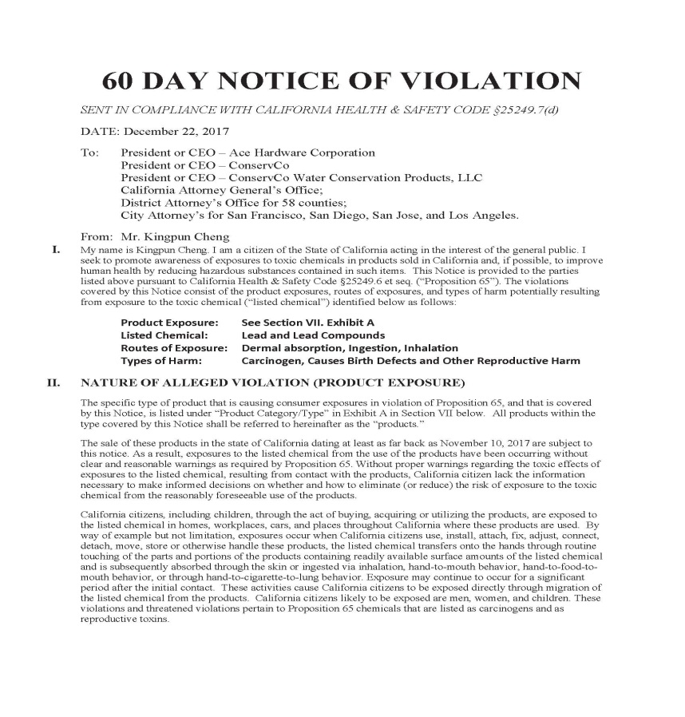
Managing a Sixty Day Notice

Slide 17
Significant Procedural Aspects of Prop 65
Sixty Day Notice
Certificate of Merit
Notice to County Prosecutors/State
Settlement Approval by Court and AG

Slide 18
60 Day Notice
Sixty Day Notice Provides Government Agencies the opportunity to decide whether to prosecute the case.
The second purpose is to give the defendant an opportunity to cure the violation.
Insufficient content may bar a case from proceeding.

Slide 19
Certificate of Merit is Required
Expert declaration that the case is meritorious is required.
If the court determines after trial that there was no actual or threatened exposure to a listed chemical, the court on motion or Sua Sponte can review the foundation for executing the certificate and issue sanctions
On September 14, 2017, the Legislature amended the certificate of merit provisions and sent AB 1583 to Governor Brown for signature in October . AB 1583 accomplished two things:

Slide 20
AB 1583
Require the Attorney General to send a letter to the private enforcer and the recipients of the 60-day notice when the Attorney General has reviewed the certificate of merit and determined that there is no merit to an action;
Make the basis for the certificate of merit discoverable in litigation, to the extent that the information is relevant to the subject matter of the action and not subject to the attorney-client privilege, the attorney work product privilege, or any other legal privilege.

Slide 21
Citizen Suit
Under Prop 65 Citizen Plaintiff obtains the right to proceed in the “Public Interest”.
It also obtains the right to seek penalties. 75% of which would go to the state and 25% to Plaintiff.

Slide 22
Defenses
Preemption
Safe Harbor Levels
Naturally Occurring (food only)

Slide 23
Settlement Issues
Most cases settle.
Business Decision
Litigation Costs vs. Settlement Costs
Provisions
Labeling.
With food, is this an option?
Usually of Existing Inventory
Reformulation
Out of Court Settlements
Res Judicata
Scope of Releases
Attorney General Letter regarding Settlement in the Public Interest

Slide 24
Defenses: Safe Harbor Intake Levels
Acrylamide: 20 µg / day
Cadmium: 4.1 µg / day
Lead: 0.5 µg / day
Ethylene oxide: 2 µg / day
Formaldehyde: 40 µg / day
4-Methylimidazole (4-MEI): 29 µg / day [effective Feb. 8, 2012]
More: http://oehha.ca.gov/prop65/getNSRLs.html

Slide 25
How Do You Determine the Threshold
Hire an expert
Quantification of the chemical concentration of a listed chemical for the exposure in question (level in question);
Multiply the level in question by the reasonably anticipated rate of an exposure for an individual to the food;
The rate of exposure must be based on the pattern and duration of exposure that is relevant to the reproductive or carcinogenic effect which formed the basis for listing the chemical as covering reproductive toxicity.

Slide 26
Many “Safe Harbor” Numbers are set by Settlement
As indicated because of the way consent judgment are negotiated among parties and then court approved many safe harbor numbers are set by litigants and their experts as opposed to the government. This can be frustrating to parties that did not participate in the process but are now burdened with a particular threshold.
May be difficult to find because they are buried in old judgments.

Slide 27
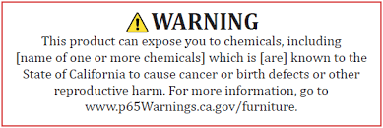
Warning Requirements

Slide 28
Clear and Reasonable
A warning is considered “clear and reasonable” within the meaning of Section 25249.6 of the Act if it complies with all of the applicable requirements of the article.
The text of a warning must include the name(s) of the listed chemicals in the consumer product or affected area for which the warning is provided. If a warning for more than one endpoint is required, the name of all the chemicals for each endpoint must be included in the warning. The exception is where a listed chemical is known to cause both cancer and reproductive toxicity and this information has been included in the warning.

Slide 29
Safe Harbor Warnings
In order to avoid confusion the OEHHA issued regulations that include the so-called safe harbor warnings that if used are presumptively sufficient.
Implicit Safe Harbor Language (and safe harbor exposure levels ) are also created by the language used in consent decrees.

Slide 30
Despite the Safe Harbor Other Warnings are allowed
Nothing in this section shall be construed to preclude a person from providing warnings other than those specified in this article that satisfy the requirements of this article, or to require that warnings be provided separately to each exposed individual.

Slide 31
Summary Of New Regulations
In summary, there is new safe harbor language, a new website for consumers, and attempts to clarify liability as between manufacturers and retailers.
The new regulations go into effect on August 30, 2018, new labels can however be used before that time.
The language required by Consent Judgments is considered within safe harbor.

Slide 32
New Regulations Continued
The new labels contain language that requires the identification of at least one of the Proposition 65 chemicals in the product. The language for each of the types of warnings (i.e. environmental vs. product) has changed.
The emphasis is for liability to the manufacturer; along with additional duties toward vendors.
There is new web Proposition 65 site sponsored by OEHHA.
There are new symbols required on the safe harbor labels.

Slide 33
Manufacturers/Retailers’ Responsibility
Manufacturer/Retail Seller Responsibilities
Product manufacturers have primary responsibility for warning.
Manufacturer can label product or provide notice to distributor/importer/retail seller that a product may cause an exposure to a listed chemical.
Provide warning signs, materials (unless they make other arrangements via contract).
Retail sellers confirm receipt of notice
Act as “pass-through” for warning
Provide non-English language warnings in certain situations.

Slide 34
Recent Changes to Warning Requirements
Overview
Clarifies responsibilities to provide warnings
Retains “safe harbor” approach for warnings to provide flexibility for businesses. Includes changes to warning methods and content
Provides for more specificity and clarity in warnings
Added “tailored” warnings for specific kinds of exposure.
Examples: dental care, furniture, diesel engines, automobiles, recreational vessels, amusement parks.

Slide 35
Consumer/Environmental Exposures
Consumer product exposure warnings must be displayed on a label, labeling, or sign in such a way that the information is “likely to be read and understood by an ordinary individual.” In other words, the warnings must be conspicuous when compared to other information contained on the same label, etc.
Environmental exposure warnings are also required to be displayed in such a manner that a typical citizen would be likely to read and understand the warnings.
The warning content may contain information which identifies the source of the exposure or provides information on how to avoid or reduce exposure to the identified chemical(s). Any such supplemental information is not a substitute for the warning content.

Slide 36
New Warning Required
This is a new section which is derived from section 25603. This section provides very specific requirements on how warnings are transmitted (communicated) to the consumer. Please pay particular attention to font size requirements and other precise obligations.
Warnings are required to meet Section 25603 requirements and be provided utilizing one or more of the following methods:
A product-specific warning, on a posted sign, shelf tag or shelf sign, is required for the consumer product at each point of display.
A product-specific warning provided via any electronic devise or process which automatically provides the warning to the purchaser prior to or during the purchase of the consumer product.
Label in compliance with Section 25603(a).
An on-product warning in type size no smaller than the largest type size used for other consumer information on the product with a minimize 6-point type
For internet purposes either a hyperlink using the world “WARNING” on the product display page or a warning compliant with Section 25603(a).
For catalog purchases, the warning must be provided in a manner which clearly associates the warning with the item being purchased. Online, catalog and on-product warnings may use the same content.
If warning is in a language other than English, an English translation must also be provided.

Slide 37
New Label Requirements
Warnings are compliant only if they use one or more of the transmissions methods identified in 25602 and includes ALL of the following elements:
A symbol consisting of a black exclamation point in a yellow equilateral triangle with a bold black outline. Where the sign, label or shelf tag for the product is not printed using the color yellow, the symbol may be printed in black and white. The symbol shall be placed to the left of the text of the warning, in a size no smaller than the height of the word “WARNING.”

Slide 38
New Requirements. Cancer Cont.
The world “WARNING” in all capital letters and bold print; and:
The following sentence must be used for exposures to listed carcinogens:”
WARNING
This product can expose you to chemicals including [name of one or more chemicals], which is [are] known to the State of California to cause cancer. For more information go to www.P65Warnings.ca.gov.”

Slide 39
New Requirements. Reproductive Harm Cont.
The following sentence must be used for exposures to listed reproductive toxicants:”
WARNING
This product can expose you to chemicals including [name of one or more chemicals], which is [are] known to the State of California to cause birth defects or other reproductive harm. For more information go to www.P65Warnings.ca.gov.”

Slide 40
Warning for Cancer and Reproductive
The following sentence must be used for exposures to both listed carcinogens and reproductive toxicants: “
WARNING
This product can expose you to chemicals including [name of one or more chemicals], which is [are] known to the State of California to cause cancer, and [name of one or more chemicals], which is [are] known to the State of California to cause birth defects or other reproductive harm. For more information go to www.P65Warnings.ca.gov.”

Slide 41
Label Requirements
If the warning addresses a single chemical, the worlds “chemicals including” can be deleted from the above mandatory sentences.
(b)An on-product warning should use all of the following elements:
(1) The symbol requirements in subsection (a) (1)
(2) The word “WARNING” in all capital letters and in bold print.
(A) The warning for consumer products which cause exposure to a listed carcinogens must include the wording “Cancer – www.P65Warnings.ca.gov.”

Slide 42
Cont.Requirements
Warning symbol
Phase In:
There was a Two-year phase-in period.
Effective date of regulation: August 30, 2018.
Consumer products manufactured prior to the effective date will not require new warnings if they meet existing safe harbor requirements.
Court-approved warnings expressly recognized and considered “clear and reasonable” for parties to litigation.
Tailored Warnings; in addition to the specific warnings listed above, the code has modified the warnings for the following categories:

Slide 43
Tailored Warnings
Environmental Exposure
Occupational Exposure
Specific Product, Chemical and Area Exposure Warnings
Food
Alcoholic Beverages
Food and Non-Alcoholic Beverages
Prescription Drug Exposure and Emergency Medical or Dental Care Exposure
Dental Care
Raw Wood Products
Furniture Products
Diesel Engines
Vehicles
Recreational Vessels
Enclosed Parking Facilities
Amusement Parks
Petroleum Products
Service Station and Vehicle Repair
Designated Smoking Areas

Slide 44
Examples of Listed Chemicals Relevant to Food Products
Acrylamide- French fries, coffee, popcorn, cereals
PhiP- cooked or grilled chicken
Phthalates- handbags, shoes, exercise equipment, crafts, tools
Cadmium- jewelry, fertilizer, artist paint
Lead- handbags, shoes, jewelry, tools, juice, honey, supplements, photo albums, paints
Arsenic- water filter systems, supplements

Slide 45
Naturally Occurring Exemption
ARTICLE 5. Extent of Exposure
§ 25501. Exposure to a Naturally Occurring Chemical in a Food
(a) Human consumption of a food shall not constitute an “exposure” for purposes of Section 25249.6 of the Act to a listed chemical in the food to the extent that the person responsible for the exposure can show that the chemical is naturally occurring in the food.
(b) A person otherwise responsible for an exposure to a listed chemical in a consumer product, other than food, does not “expose” an individual within the meaning of Section 25249.6 of the Act to the extent that the person can show that the chemical was a naturally occurring chemical in food, and the food was used in the manufacture, production, or processing of the consumer product. Where a consumer product contains a listed chemical, and the source of the chemical is in part from a naturally occurring chemical in food and in part from other sources, “exposure” can only occur as to that portion of the chemical from other sources.
NOTE: Authority cited: Section 25249.12, Health and Safety Code Section. Reference: Section 25249.6, Health and Safety Code.

Slide 46
Defenses: Naturally Occurring
People ex rel. Edmund G. Brown Jr. v. Tri-Union Seafoods, LLC, 171 Cal. App. 4th 1549 (2009)
Court found that the mercury that was in tuna was naturally occurring, although the Court did leave the door open for additional evidence otherwise.

Slide 47
Defenses: Naturally Occurring
No duty relative to the exposure if caused by chemicals that naturally occur in the food product.
Is a defense only to the extent you can prove that the chemical is naturally occurring by expert testimony- there can no man-made component.
May require extensive research going back to the place where it is grown.
Expensive and difficult to prove.

Slide 48
Environmental Law Foundation v. Beech-Nut et al (Alameda Superior Court 2013)
Recent case with respect to food and fruit juice with alleged lead levels
Court found:
No Federal Preemption
Insufficient Proof that the lead was Naturally Occurring
Did find that the Exposure Assessment was done correctly and allowed the use of average dosages over time, rather than looking at acute exposure

Slide 49
Final Suggestions
Clients need to know what's in their product
Need to know whether you exceed the Safe Harbor or Settlement thresholds
If Client can need to contractually place the onus on Client’s suppliers to meet the regulations
Insurance for Proposition 65 if possible
Do as much negotiating during can do the sixty notice period in the Proposition 65 cases
Make business decision as to how to proceed
You need to have an attorney and expert on call to handle these issues

Slide 50
Contact Information
LEE N. Smith  Partner  559-248-4820
Fresno Visalia Bakersfield Los Angeles Sacramento
JACK C. HENNING  Partner  415-397-2700
50

Slide 52
Determining Compliance for Proposition 65
Ankur Sinnghal | Managing Scientist | Health Sciences 510.268.5016 | asinghal@exponent.com
March 28, 2018

Slide 53
Proposition 65 Compliance Strategies
Option 1: WARN. However…
New 2018 warnings requirements
Not reasonable in some situations
Branding issues/competitor products
Some retailers do not want Prop 65 labeled products
Over-warning issue
Unlikely to be served with a 60-day notice but …
Requires a well-managed labeling program
Be ready for customers’ inquires/questions, aggressive public interest groups
Be ready for plaintiffs to look for inaccurate/“improper” 2018 labels

Slide 54
Proposition 65 Compliance Strategies
Option 2: Demonstrate exposure is below Safe Harbor Level. However…
Requires that you know what’s in your products
Requires conducting technical assessment of your products
In-house product testing from each supplier
Documentation program
Internal checks/auditing – off-the-shelf testing
You may still be served with a 60-day notice but you will be prepared
Often technical exposure assessments are used in settlement negotiations
Regardless of the potential for Prop 65 litigation, some just want to know the answer and have the documentation.

Slide 55
What is a Safe Harbor Level?
NOT an easily understood value
What it is NOT:
Not the concentration of a chemical in product
Not the % of chemical in a product
Not the same level as other U.S. or international product requirements
What it IS:
Dose or exposure (in µg/day) from typical use of product
Lead: 0.5 µg/day;
Diethylhexyl phthalate (DEHP): 410 µg/day
Formaldehyde: 40 µg/day
For a few chemicals (e.g., lead and phthalates), Prop 65 settlements have morphed into content requirements for ease of implementation

Slide 56
Safe Harbor Levels
For carcinogens – no significant risk level (NSRL)
E.g. acrylamide and formaldehyde
For reproductive toxicants – maximum allowable dose level (MADL)
E.g. lead and DEHP
Not available for all listed chemicals

Slide 57
Routes of Exposure
Inhalation, ingestion and dermal routes
Route(s) depend on the chemical and use scenario of product
e.g.
Formaldehyde emissions from wood products – Inhalation
Lead from brass products – Incidental ingestion from hand to mouth contact
Phthalates from PVC cords – Dermal and Ingestion
Acrylamide from food products – Ingestion only

Slide 58
Exposure Assessment
Conduct exposure simulations in a representative use scenario!!!
Chemicals used in product ≠ chemicals dislodged from product (exposure)
Different products require different exposure scenarios based on their handling in real-life
Determines how to conduct product testing

Slide 59
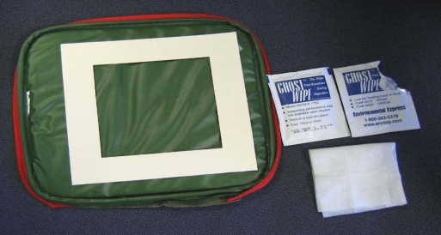
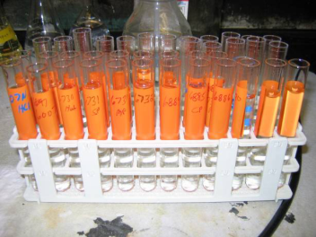
Testing Methods
Product-use simulation
Handle/use product – wipe skin area in contact with product
E.g. lead in brass products or DEHP in PVC cords
Emissions testing
To understand concentration in a living space
E.g. formaldehyde from wood products
Leaching
To understand chemical unloading when mouthed
E.g. phthalates in children’s toys
Total content testing typically not representative of exposure for these scenarios!!!

Slide 60
Case Study: DEHP in PVC Tool Handle Cover
Exposure scenario
Typical use by an adult
Anticipated exposure during use of tool
Estimated contact duration will depend on tool but let’s assume 30 minutes per day
Exposure assessment
Volunteer handles the tool, e.g. clasps, in anticipated manner for 30 minutes
Collect wipe samples from hand contact area after this duration
Analyze for DEHP and estimate ingestion and dermal exposure in µg/day for comparison to MADL of 410 µg/day

Slide 61
Case Study: Formaldehyde in Laminate Flooring
Exposure scenario
Formaldehyde emissions into indoor air from laminate flooring
Estimated duration of exposure – 12 hours a day spent at home
Exposure assessment
Evaluate emissions from flooring in a chamber
Estimate indoor air concentrations from total flooring coverage and other necessary parameters
Calculate lifetime inhalation daily dose (formaldehyde is listed as a carcinogen)
Compare to NSRL of 40 µg/day

Slide 62
What Should You Do?
Identify your at-risk products
Understand if Prop 65 chemicals are present
Is Prop 65 chemical easily identified (i.e., brass)?
Evaluate potential exposure risk from use of your products
Consider business and legal risks
Identify compliance strategy for different products
Label, Or
Demonstrate exposure is below Safe Harbor Level
Consider applying for an SUD

Slide 63
Safe Use Determination (SUD)
“…a written statement issued by OEHHA, which interprets and applies Proposition 65 and its implementing regulations to a specific set of facts in response to a request by a business or a trade group. Requests for SUDs seek OEHHA’s determination whether an exposure or discharge of a listed chemical resulting from specific business actions or the average use of a specific product is subject to the warning requirement or discharge prohibition.”
Work with OEHHA to develop an SUD for your product
Must be prior to receiving any notice of violation (NOV)
Many businesses/trade groups are choosing this route

Slide 64
Thank you – QUESTIONS?
Ankur Singhal Managing Scientist | Health Sciences 510.268.5016 | asinghal@exponent.com

